Slide 1
Dependency Injection
with StructureMap

Slide 2
Why?
Dependency Injection is the “D” in S.O.L.I.D. A best-practices approach for developing object-oriented codebases
  SOLID is “new” to the mainstream Microsoft community. Tenets have roots going back to SmallTalk
  When applied, it provides re-usable, loosely coupled code, that embraces change.
Notes:
SOLID architecture is fully embraced in the Java, ALT.NET and Agile communities
Good OO design allows us to expose a solution to a problem without requiring the consumer to fully understand the problem domain.
Re-usable means the entire system has ONLY ONE place to go for a specific function/solution

Slide 3
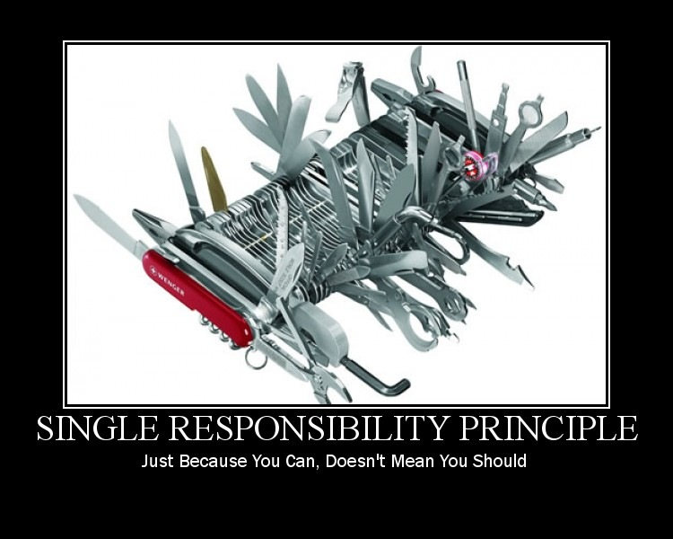
Notes:
Compose classes around the principle: Only one reason for this to change
Typical violations:
Knows how to construct data access
Knows how to access configuration settings

Slide 4

Notes:
You can add functionality to a system WITHOUT breaking existing callers

Slide 5

Notes:
Don’t try to get cute with polymorphism

Slide 6
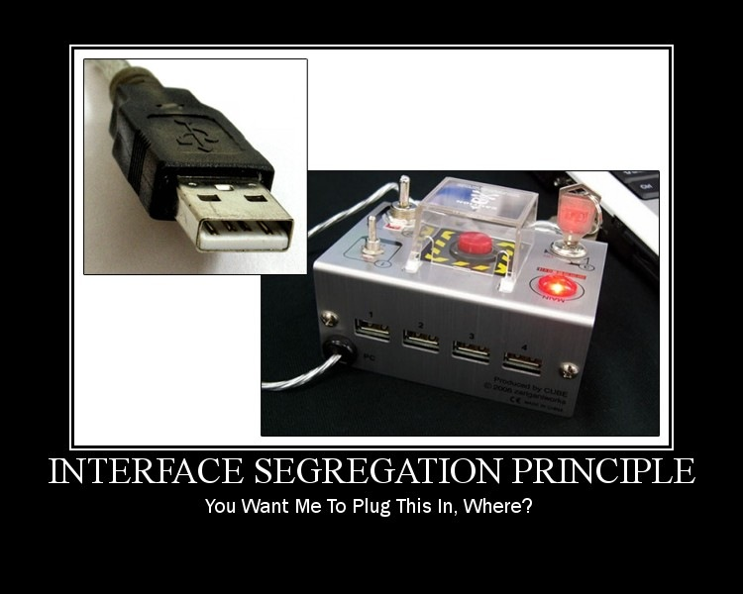
Notes:
Meaning: Clients should not be forced to depend on interfaces they do not use

Slide 7
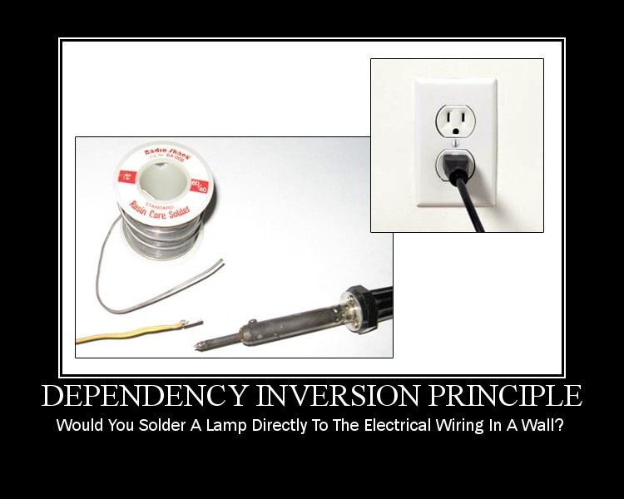
Notes:
Abstractions FTW
Contracts are the key.
Gas certification/grades allow us to use different gas stations. Money allows us to exchange goods and services.

Slide 8
Dependency Injection
Inversion of Control
  Consumer shouldn’t need to know how to construct what it needs (SRP)
  Depending on abstractions allows the system to be extended (OCP)
  Using a contract to agree on behavior (LSP)
  Consumer could require several abstractions (ISP)
How to do IoC
  Poor man’s DI
  Factories
  IoC Containers
Notes:
Constructor injection preferred as it clarifies intent and instantiates objects in the correct state
Cons:
Poor man’s DI --- single responsibility, OCP
Factories --- manual
IoC containers --- magic of resolution

Slide 9
StructureMap
Resolution – container.GetInstance<IFoo>
Registration – container.For<Ifoo>.Use<Foo>
Auto-Wiring
Scoping – Singleton, HttpContext, ThreadLocal, Hybrid

